Slide 1
Jenkins
-- for Continuous Integration

Slide 2
Jenkins
Jenkins is a software that allows continuous integration and continuous Delivery/Deployment.

Slide 3
Hudson
Along with Jenkins, sometimes, one might also see the association of Hudson. Hudson is a very popular open-source Java-based continuous integration tool developed by Sun Microsystems which was later acquired by Oracle. After the acquisition of Sun by Oracle, a fork was created from the Hudson source code, which brought about the introduction of Jenkins.

Slide 4
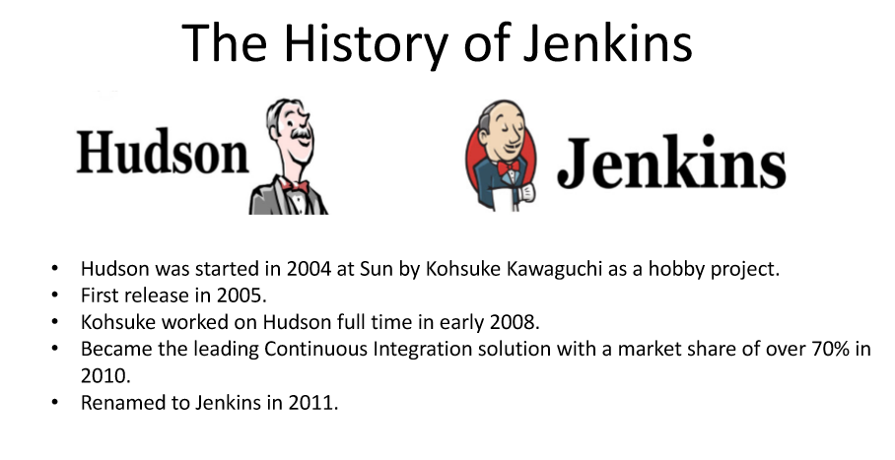

Slide 5
What Is Continuous Integration?
Continuous Integration is a development practice that requires developers to integrate code into a shared repository at regular intervals. This concept was meant to remove the problem of finding later occurrence of issues in the build lifecycle. Continuous integration requires the developers to have frequent builds. The common practice is that whenever a code commit occurs, a build should be triggered.

Slide 6
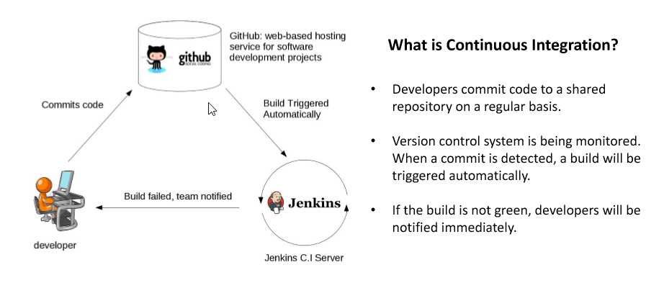

Slide 7
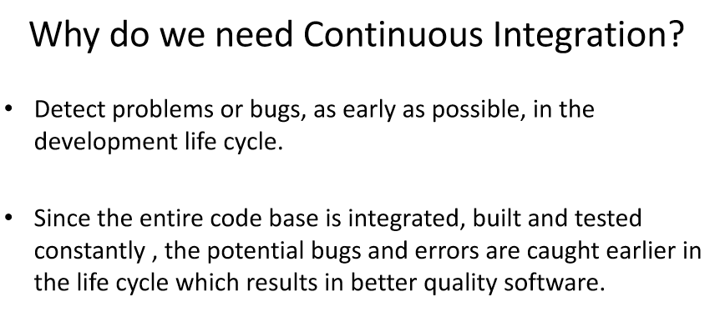

Slide 8
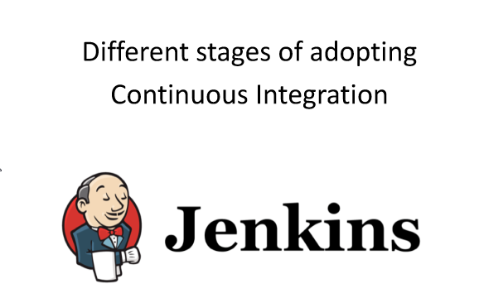

Slide 9
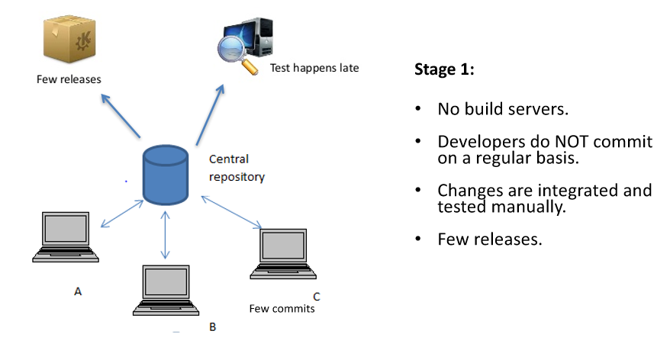

Slide 10
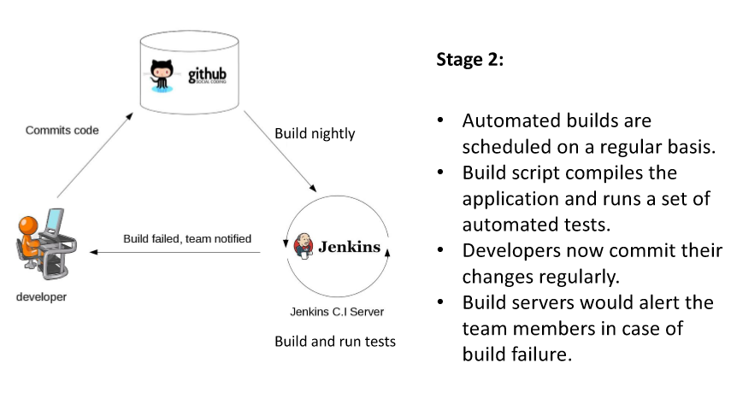

Slide 11
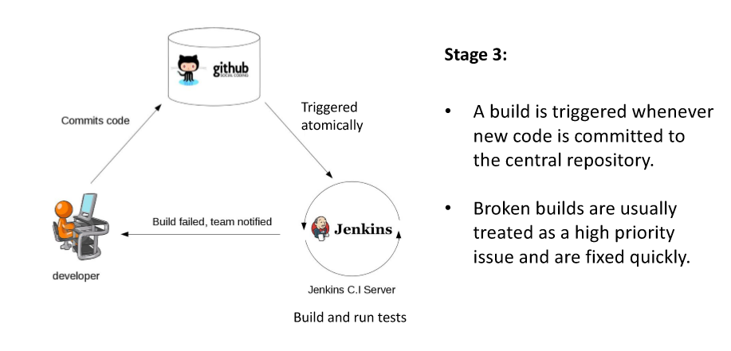

Slide 12
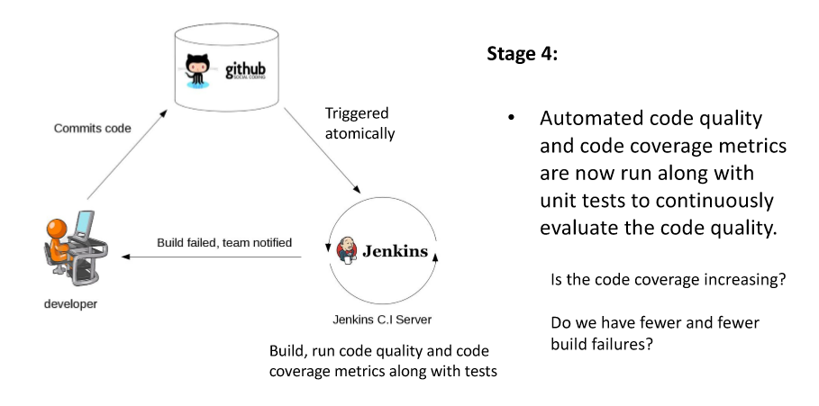

Slide 13
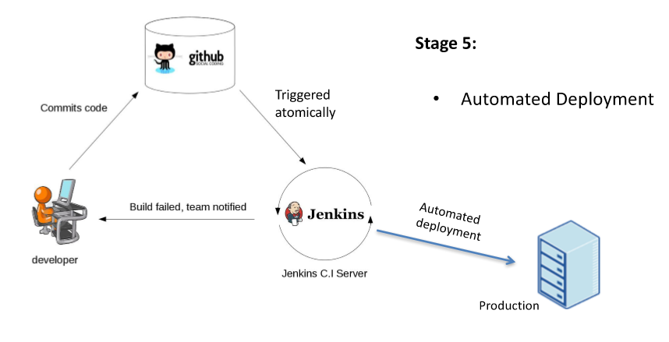

Slide 14
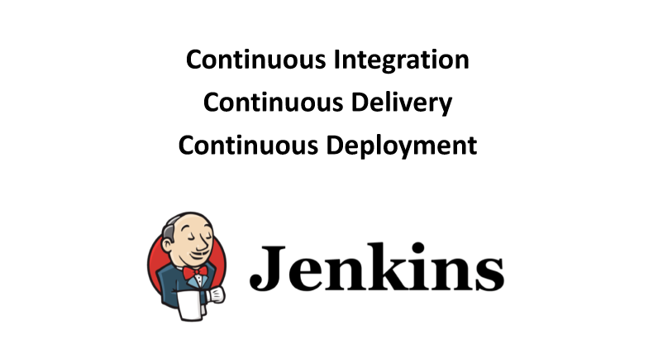

Slide 15
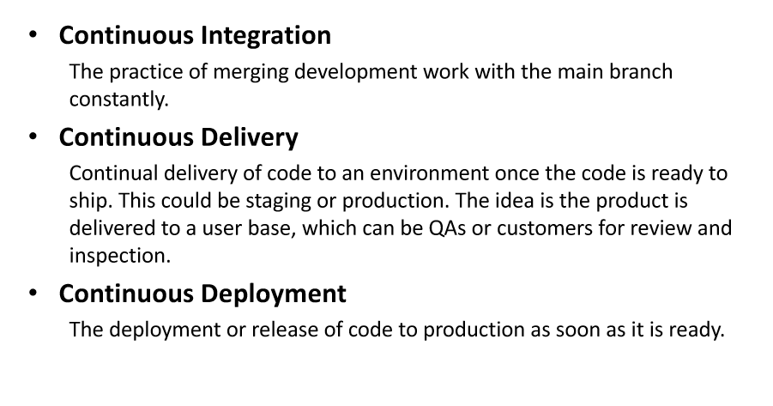

Slide 16
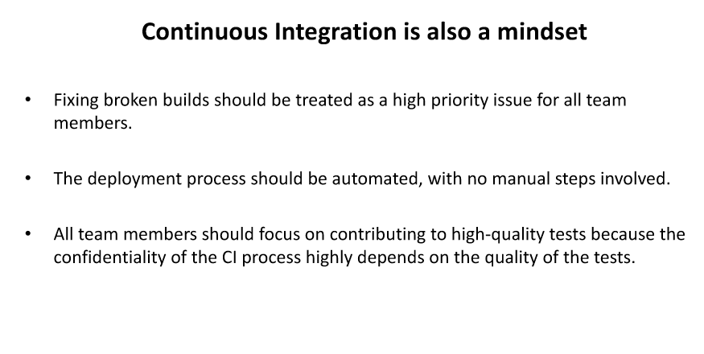

Slide 17
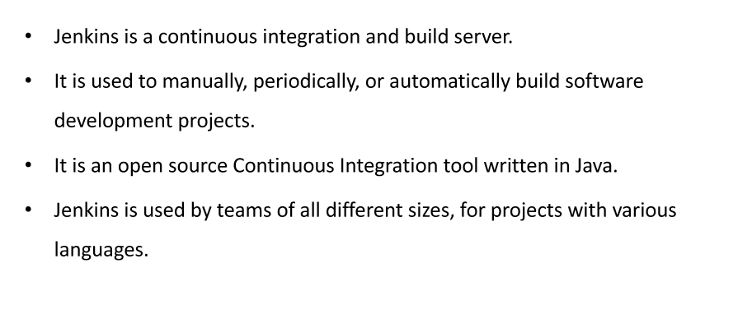
Another Definition

Slide 18
Why Only Jenkins
Everybody loves one-button click philosophy, both users and engineers.
With Jenkins, we can combine multiple jobs together, which then serve a bigger problem. The combination could be either sequential or parallel.
For troubleshooting, we know the history, crystal clear. No need for a human to capture the console output and spend time organizing it in a user-friendly way. The time saved for communication is huge!
Project Management Now Has More Accurate Data Support

